Slide 1
NORDUnet IP Network
NORDUnet
Operational Meeting
06-30-2011

Slide 2
Components
US Expansion
European peering ring upgrade
Customer upgrades
100GE Testing

Slide 3
US Expansion
Additional PoP in Ashburn, VA
  Equinix site
  High density of networks
Additional 10G transatlantic capacity
  STM64 London – Ashburn (GLORIAD)
  Proper redundant capacity to the US
Domestic STM64 NYC - Ashburn
Second US IXP presence
  Largest peering-fabric in North America
    Traffic volume + Connected parties

Slide 4
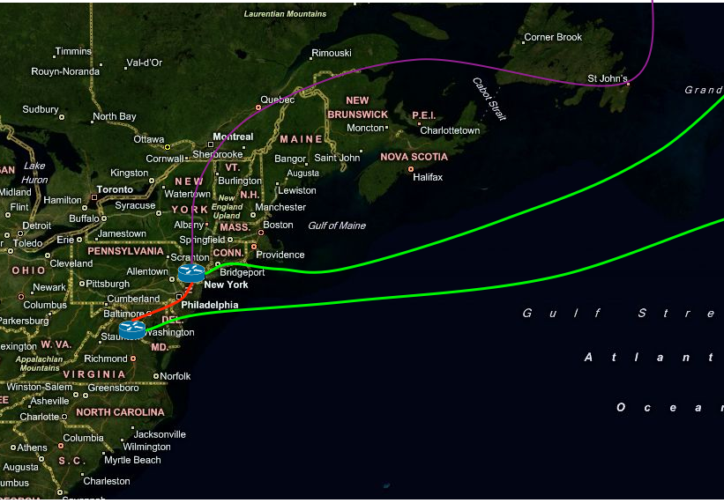
US Plans

Slide 5
European ring upgrade
Provide sufficient capacity for additional US traffic and resiliency for peering traffic
Change from SDH to Ethernet
Additional 10GE capacity on each segment
  2x 10GE CPH – AMS
  2x 10GE CPH – LON
  2x 10GE AMS – LON
Upgrade AMS-IX by end 2011

Slide 6
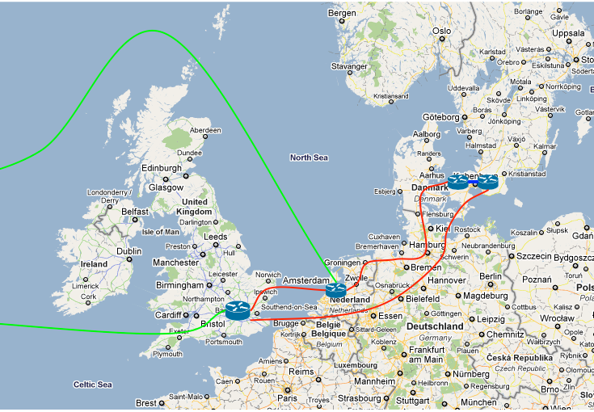
European Overview

Slide 7
Customer upgrades
UNINETT
  Upgrade overdue (Regardless of CBF)
FUNET
  Upgrade to 2x 20GE needed by late 2011
SUNET
  No upgrades required in 2011
FSKnett
  Potential upgrade needed early 2012
RHnet
  No upgrades required in 2011

Slide 8
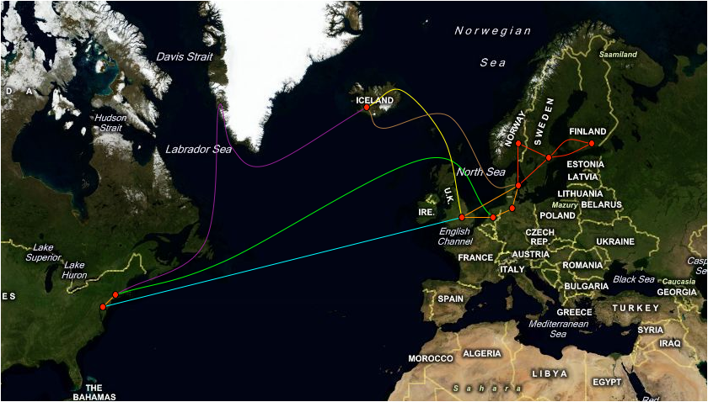
Target 2011
NORDUnet IP Network 2011

Slide 9
100GE Testing
Still on-going – 12 week loan
Stockholm (FRE) – Copenhagen (ORE)
Juniper T1600 - Beta 100GE FPC LR4
Alcatel-Lucent 1830 PSS – 100GE LR4
Channel/control-plane working
Only unidirectional dataplane(!)
Juniper/ALU Investigating

Slide 10
The End
Questions?

